Slide 1
Puyallup Avenue – Transit Complete Street Improvement – Project Update
City of Tacoma | Public Works Department
RFQ Design Support Services
February 24, 2022
Notes:
Template Read-Me
Do not insert animations or slide transitions into your presentation.
Use only sans serif fonts (i.e.: Arial, Tahoma, Helvetica).
Fonts must be between 24 points and 32 points in size. The minimum point size allowed is 18.
Avoid having too much text.
If the text flows outside the safe title area, split the information into two or more slides.
Pictures with white backgrounds should be toned down by right clicking the mouse on the picture, then selecting Format Picture, lower the brightness by 10%.
Ensure graphics (pictures, charts) are high resolution so they can be easily viewed on screen.
The Safe Area grid lines that you see on the background should be removed when your presentation is completely formatted.
To remove the grid lines: Select the View tab. On the left side of the upper tool bar, click on Slide Master. Select the top most slide in the list. (You may need to scroll)
To select the Safe Area we suggest clicking on the upper left corner of the object. Once it highlights, press delete. Save your presentation.
Alternatively you may hide the Safe Area by clicking Hide Background Graphics in the Design tab for each slide in your presentation. (However, make sure this action does not also affect other graphics you have added to your presentation.)

Slide 2
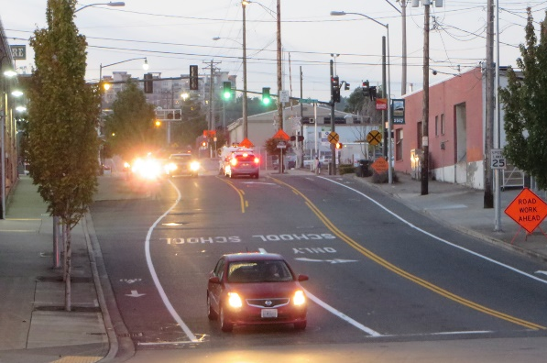
OVERVIEW
Project Goals & Summary
Outreach & Conceptual Design Outcomes
Recent Stakeholder Outreach
Next Steps

Slide 3
PROJECT GOALS
Support multimodal uses and embrace complete street concepts
Enhance the experience for everyone, including pedestrians, cyclists, drivers, transit riders, and freight operators
Make Puyallup Avenue an inviting place where people want to visit

Slide 4
PROJECT SUMMARY
S. C Street to Portland Avenue
1.2 Miles of Reconstructed Heavy-Haul Roadway
Widened Sidewalks, Curb Ramps, Crosswalks, Bicycle Facilities, Landscaping
New Fiber/Interconnected Signals, APS, Lighting
Urban Design/Placemaking/Connectivity

Slide 5
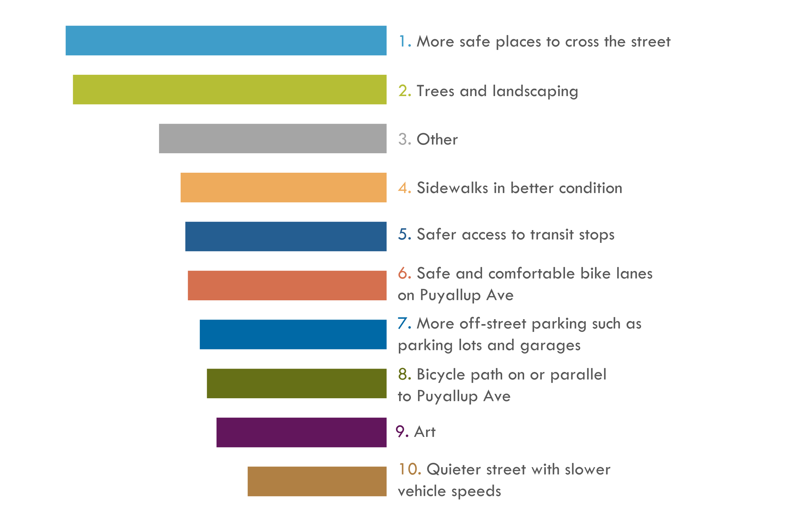
2016-2017 PUBLIC FEEDBACK
In terms of transportation, what would make Puyallup Avenue more attractive to you?
Other: Safety/streetlight/ storefront improvements, road maintenance, better transit/ped/bike connections, more retail/mixed use destinations, noise reduction (train/construction), parking, gateway features

Slide 6
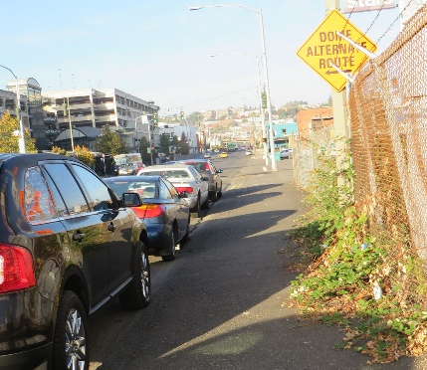
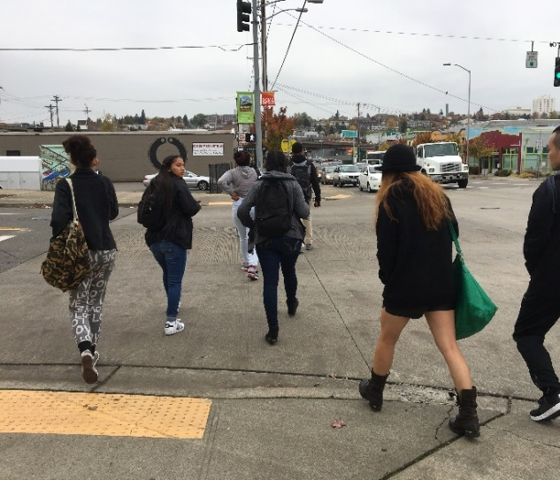
2016-2017 STAKEHOLDER FEEDBACK
Want Subarea Plan efforts to come to fruition
Need access to TDS
Parking is increasingly an issue
Must be safe and comfortable for pedestrians, especially students
Doesn’t currently feel like a safe street to bike
Preserve the unique historic and industrial character
Acts as a gateway for people arriving in Tacoma by transit or for events
Make it feel like a place

Slide 7
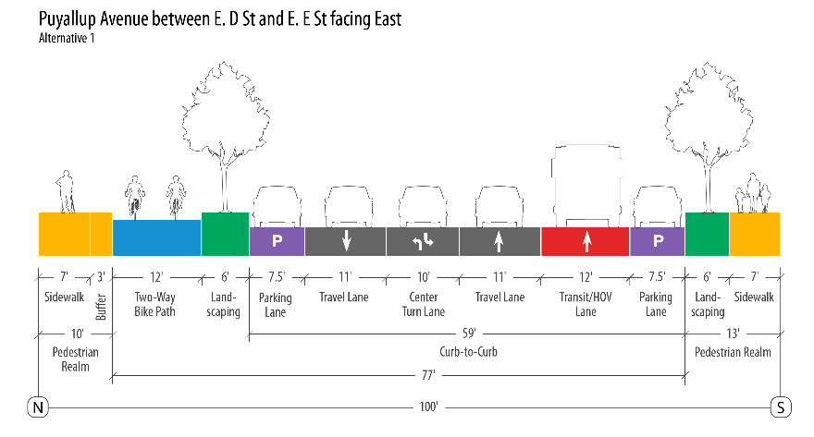
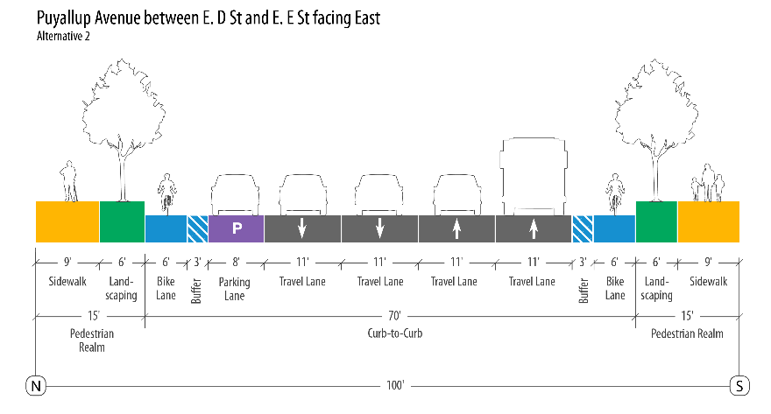
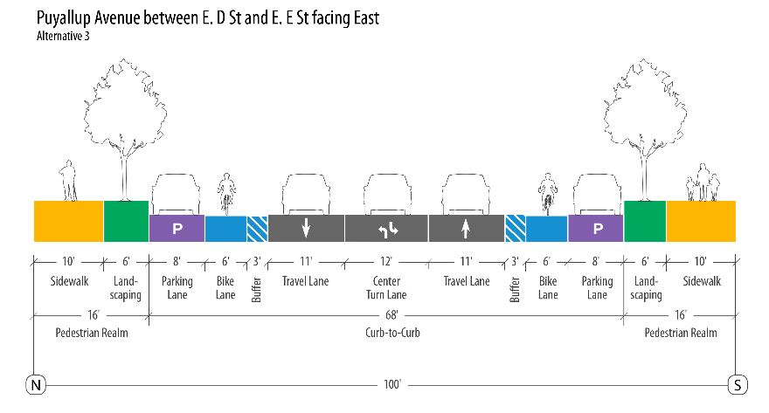
PROPOSED ALTERNATIVES 1-3
Alternative 1
Alternative 2
Alternative 3

Slide 8
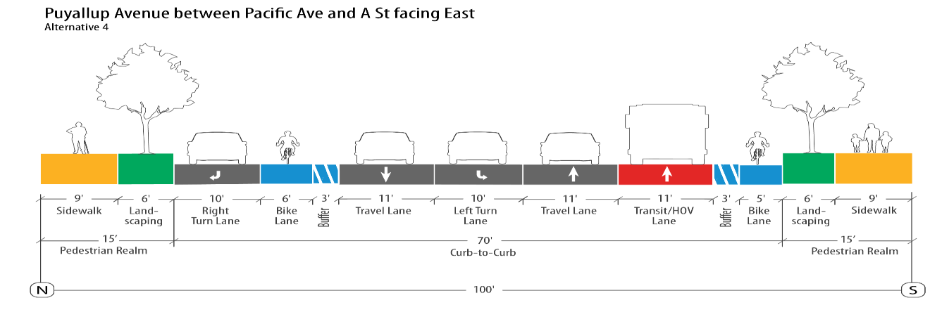
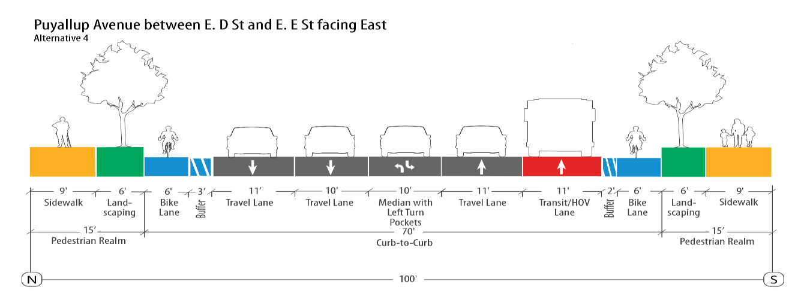
HYBRID ALTERNATIVE 4
Similar to Alternative 1
A St & E G St
Similar to Alternative 2

Slide 9
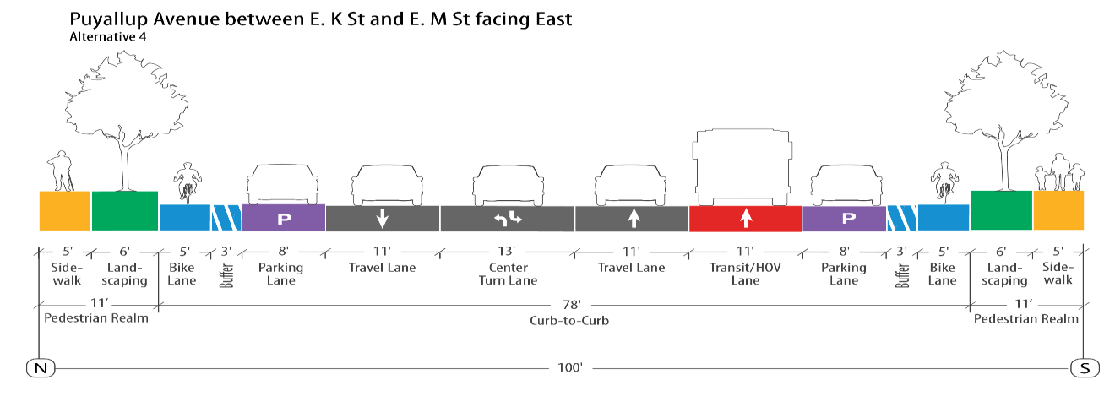
HYBRID ALTERNATIVE 4
Similar to Alternative 1

Slide 10
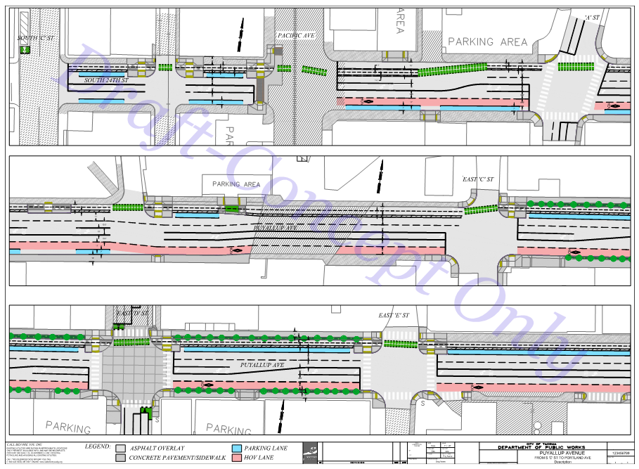
ALTERNATIVE 4 – CONCEPT LAYOUT
See Google Maps

Slide 11
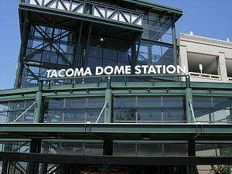
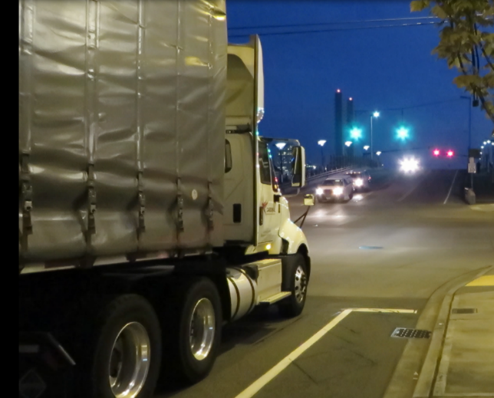
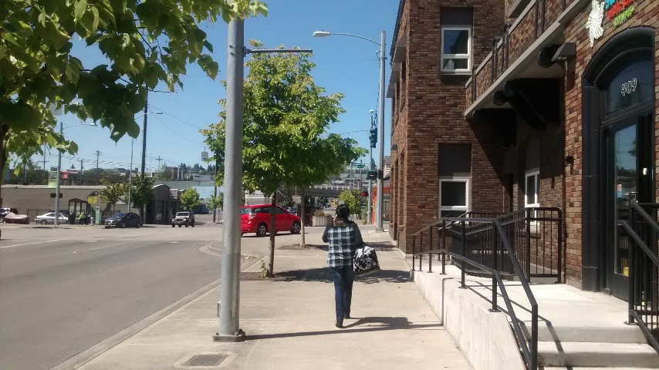
RECENT STAKEHOLDER OUTREACH
Stakeholder Outreach Restarted in Sept ‘20
Letters of Support Received
Jan ‘21 - Bicycle Pedestrian Technical Advisory Group (BPTAG)
Feb ‘21 - Transit-Oriented Development Advisory Group (TODAG)
March ‘21 - Transportation Commission

Slide 12
STAKEHOLDER FEEDBACK
TRANSPORTATION COMM. | TODAG | BPTAG
Prioritize safe and connected pedestrian, bicycle, and transit facilities | Balance pedestrian and bicycles facilities, and on-street parking | Prioritize safe and connected pedestrian, bicycle, and transit facilities
De-emphasize on-street parking on Puyallup Ave | Prioritize no net loss of on-street parking on Puyallup Ave | Add on-street parking to side streets and utilize management strategies
Bi-directional protected bicycle facility | Protected bicycle facility with buffer | Bicycle connectivity (protected) for the entire length
Add east and west-bound transit/BAT/HOV lanes | Add transit lane to one side | Discuss needs of transit/HOV lanes (2?) with transit agencies
Freight access is critical, possible freight use of transit/HOV lane(s) | Ensure safe operations, however, balance freight with other needs | No specific freight comment

Slide 13
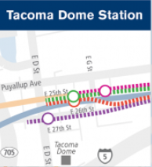
DESIGN CRITERIA
Segment 1: Neighborhood District - Pacific Ave to E. D St.
Maximize parking by:
Maintaining curb-side parking (no net loss along Puyallup Ave, if possible)
Added angle parking along side streets, to the extent possible
Wide sidewalks w/ walkable, pedestrian friendly amenity zones
Protective street-edge landscape / street-tree buffer
Pedestrian safety (lighting, CPTED)
Segment 2: TOD District - E. D St. to E. G St.
Same 4 bullets as in the Neighborhood District
Ease of crossing and access to transit
If available, consider TDLE improvements / connections in relation to Puyallup Ave design
Long term – Develop recommendations regarding use and timing of HOV / transit lane

Slide 14
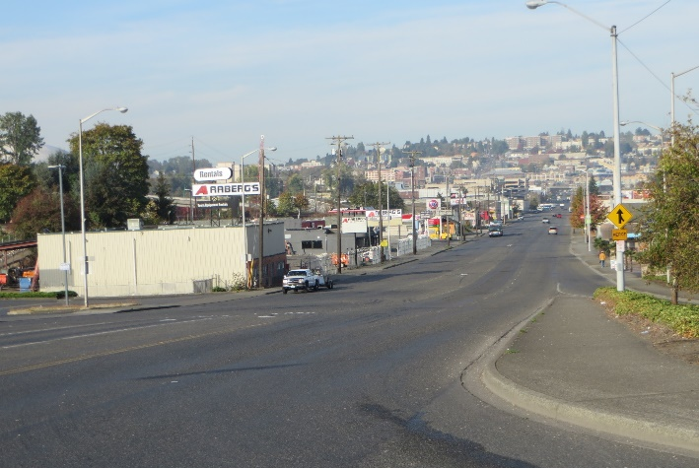
DESIGN CRITERIA
Segment 3 - Industrial District - E. G St. to Portland Ave.
Gateway to Tacoma
Maintain parking
Consider higher freight use / improvements in this part of the corridor
Improved sidewalks and signage
Consider bicycle connections to destinations beyond Portland Avenue
Protective street-edge landscape / street-tree buffer
Pedestrian safety (lighting, CPTED)

Slide 15
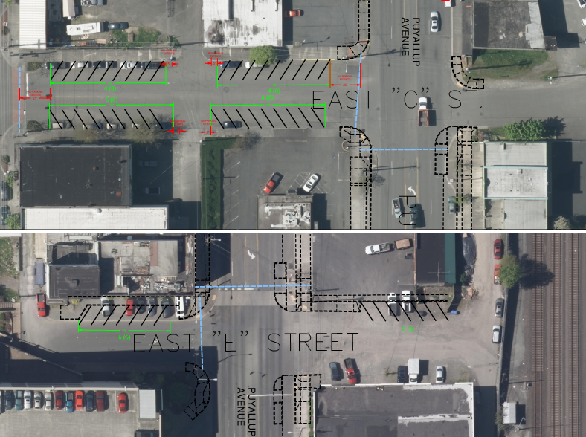
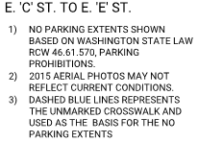
Draft/Concept Review – E. C St. to E. E St. Tentative Side Street Parking Options
Tentative/Proposed Stall Count:
23 Existing
44 Proposed
21 Gained
Dimensions/layout cannot be confirmed until survey is complete & stall placement reviewed by Traffic Section.
Final stall count may be significantly less than shown.

Slide 16
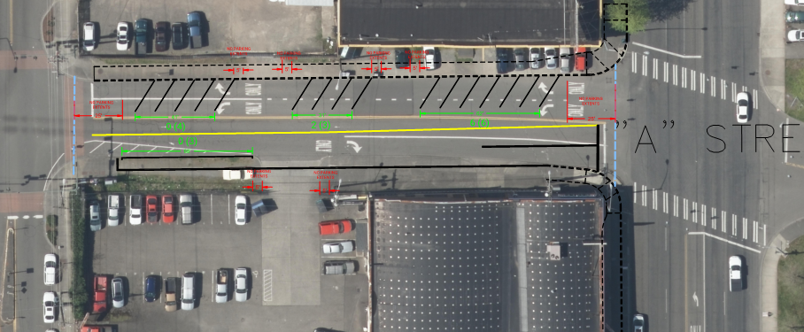
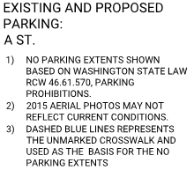
Draft/Concept Review – A St. to E. C St. Tentative Side Street Parking Options
Tentative/Proposed Stall Count:
8 Existing
16 Proposed
8 Gained
Dimensions/layout cannot be confirmed until survey is complete & stall placement reviewed by Traffic Section.
Final stall count may be significantly less than shown.

Slide 17
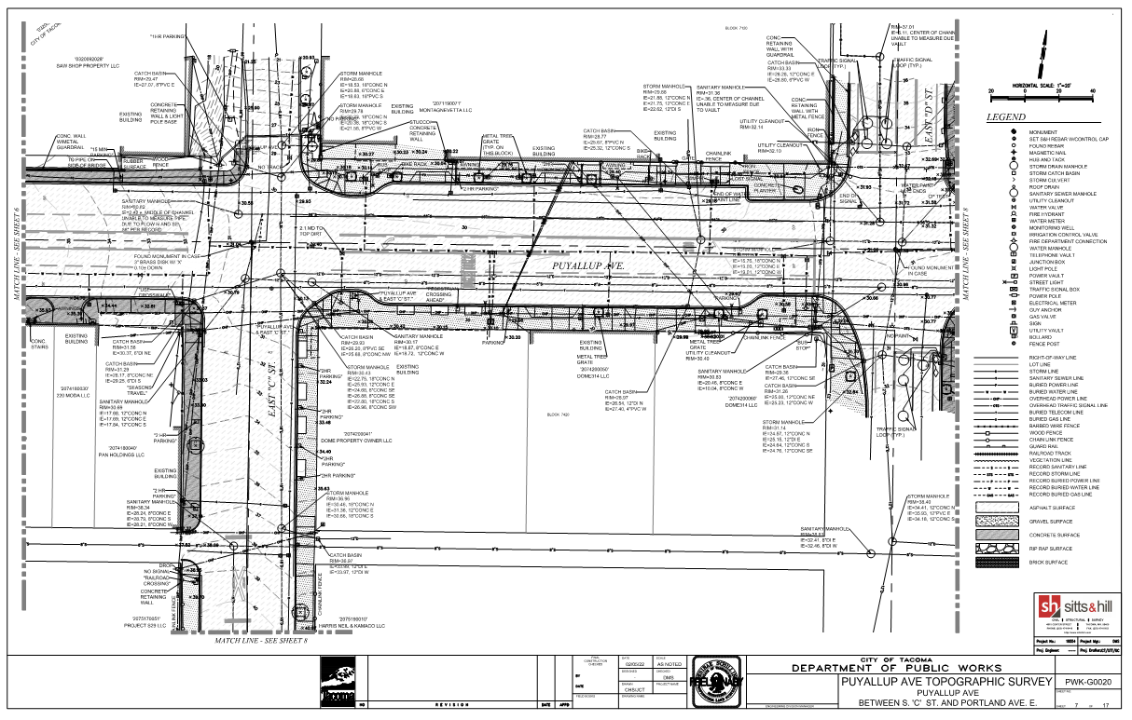
SURVEY

Slide 18
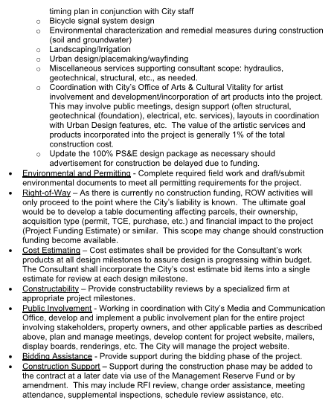
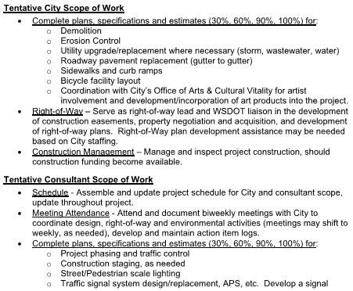
DESIGN SUPPORT SCOPE

Slide 19
NEXT STEPS

Slide 20
Puyallup Avenue – Transit Complete Street Improvement – Project Update
City of Tacoma | Public Works Department
RFQ Design Support Services
February 24, 2022
Notes:
Template Read-Me
Do not insert animations or slide transitions into your presentation.
Use only sans serif fonts (i.e.: Arial, Tahoma, Helvetica).
Fonts must be between 24 points and 32 points in size. The minimum point size allowed is 18.
Avoid having too much text.
If the text flows outside the safe title area, split the information into two or more slides.
Pictures with white backgrounds should be toned down by right clicking the mouse on the picture, then selecting Format Picture, lower the brightness by 10%.
Ensure graphics (pictures, charts) are high resolution so they can be easily viewed on screen.
The Safe Area grid lines that you see on the background should be removed when your presentation is completely formatted.
To remove the grid lines: Select the View tab. On the left side of the upper tool bar, click on Slide Master. Select the top most slide in the list. (You may need to scroll)
To select the Safe Area we suggest clicking on the upper left corner of the object. Once it highlights, press delete. Save your presentation.
Alternatively you may hide the Safe Area by clicking Hide Background Graphics in the Design tab for each slide in your presentation. (However, make sure this action does not also affect other graphics you have added to your presentation.)

