Slide 1
Tacoma PD Organizational Health Resource

Slide 2
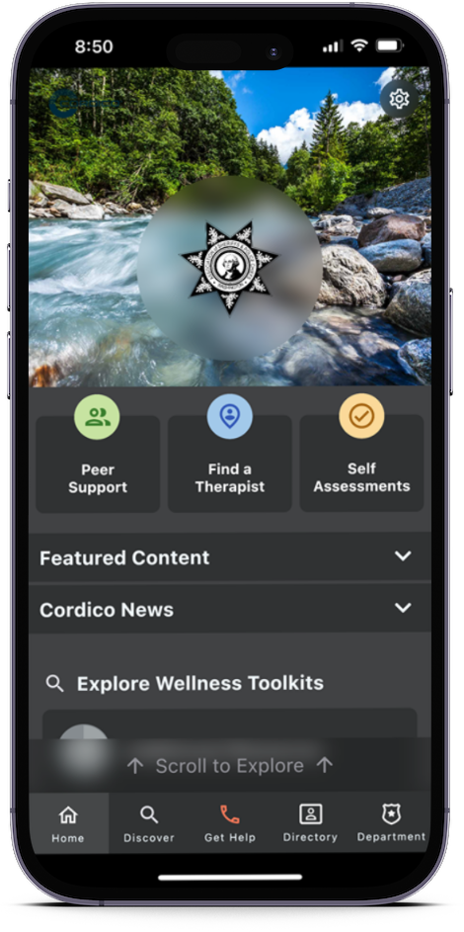
Washington Association Of Sheriffs and Police Chiefs Presents

Slide 3
Cordico Wellness App Gordon Graham & Dr. David Black

Slide 4
Confidential and Anonymous
No personal Information is collected
No personal login needed
Use Department login
No data or history saved to a device

Slide 5
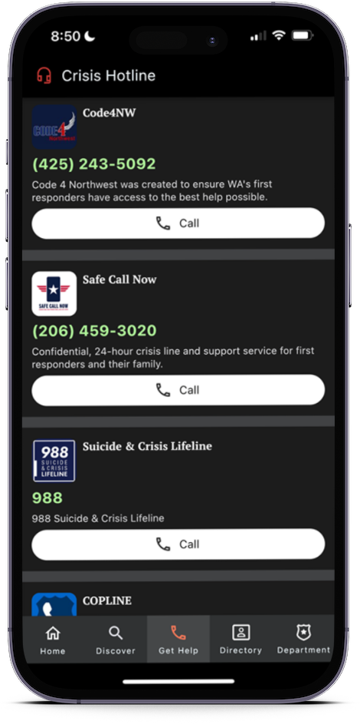
Get Help Now
If you are in crisis or want to talk with someone immediately, one tap to connect to:
Code4NW for WA First Responders
Safe Call Now for Fire Responders
Copline for LE Professionals
Suicide Prevention Line

Slide 6
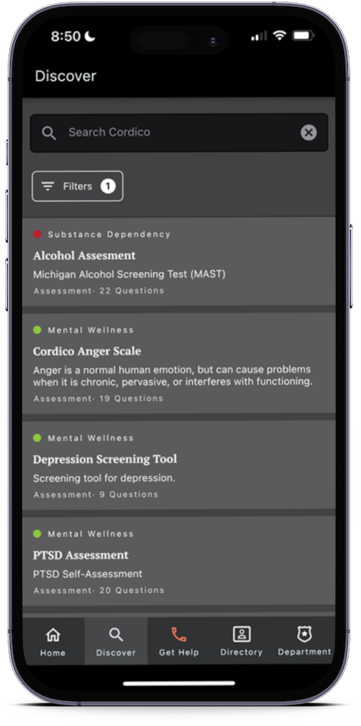
Anonymous Self-Assessments
Multiple modules:
Alcohol
Anger
Compassion Fatigue
Depression
PTSD
And more
Only YOU see the results

Slide 7
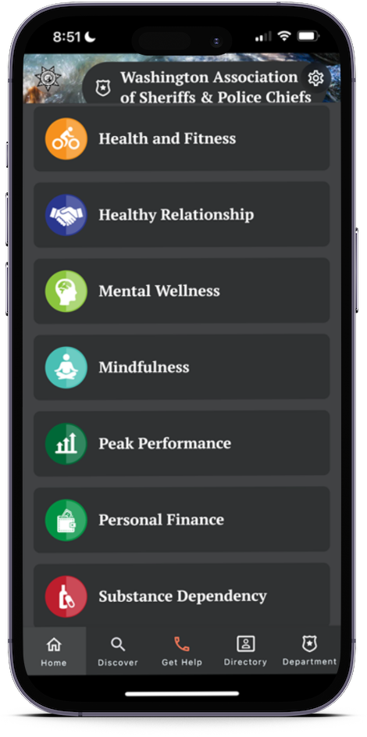
Wellness Toolkit
60 behavioral health topics
Alcohol Abuse
Critical Incidents
Depression
Family Support
Financial Fitness
Emotional Survival
Marriage Guidance
Mindfulness
Developed by experienced
first responder psychologists

Slide 8
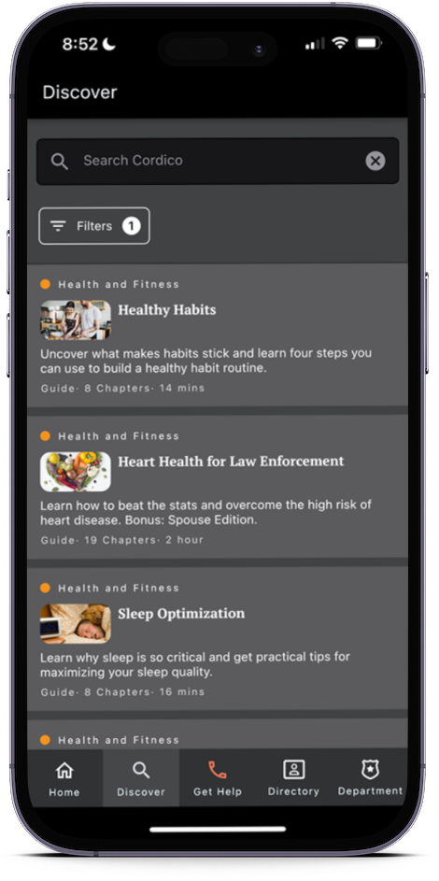
Nutrition toolkit & Weight Loss Challenge
Nutrition tips and FAQs
Guided weight loss challenge
Additional nutrition resources

Slide 9
Fitness and injury prevention
Yoga for First Responders
Physical Therapy Videos
Injury Prevention Tips

Slide 10
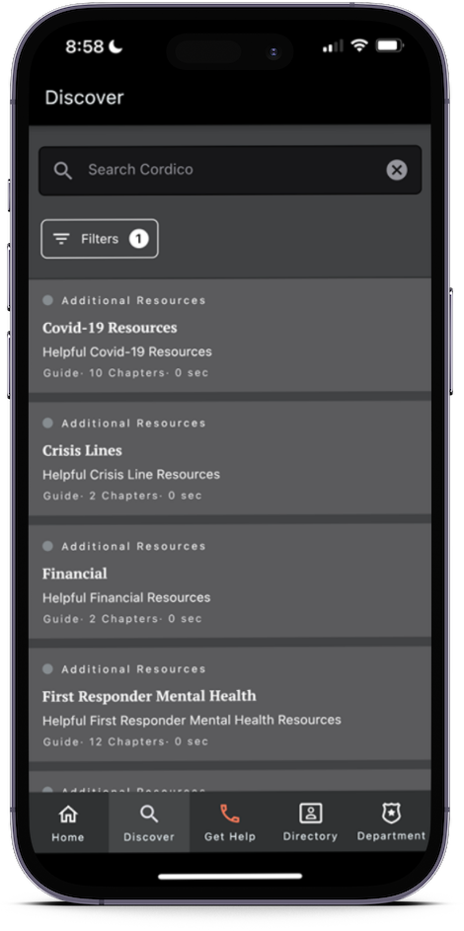
Additional Resources
National non-profits and industry organizations
Advocacy and support groups
Industry Publishers

Slide 11
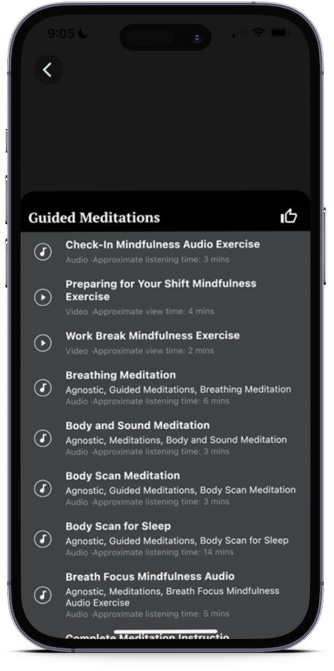
Relaxation & Mindfulness
Guided Meditation
Sleep Sounds

Slide 12
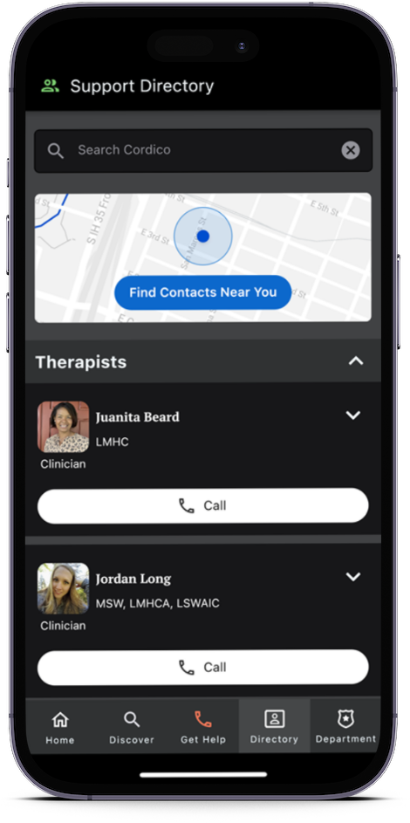
Therapist Locators
Listing of Vetted Therapists
Brief Bio
Therapist Location
One-touch Map Direction
Click to Call

Slide 13
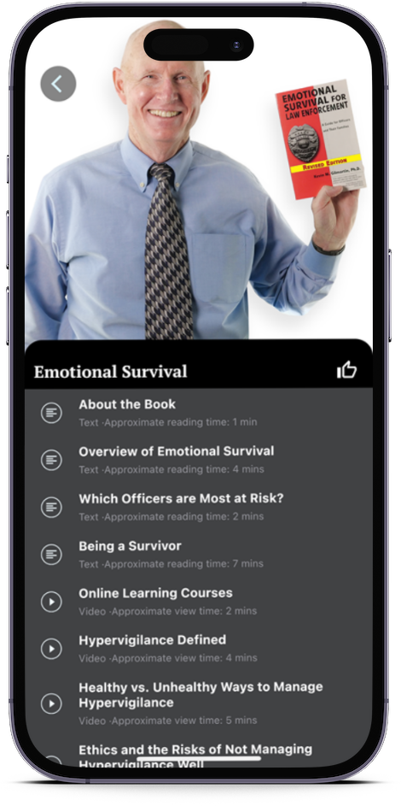
Dr. Gilmartin Emotional Survival
Content from the nationally
renowned expert in officer
Wellness
Author of Emotional Survival
for Law Enforcement

Slide 14
Available to spouses/ significant Others & Retired LE
No charge to you or the Department
Family-Specific resources such as marriage, financial support, etc.

Slide 15
Anonymous Feedback
In SETTINGS you can rate and review the app directly to Lexipol
Let us know
what you like
what more you’d like to see
What you think could be better

Slide 16
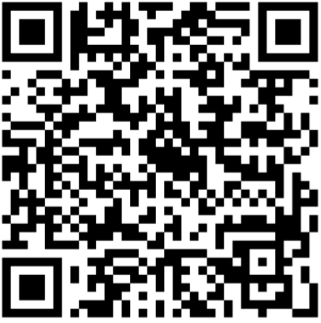
Download now
Scan the QR code with your phone’s camera to Download the app
Or Search Cordico Wellness in the App Store or Google Play
Enter TPD Credentials
Department IDs:
TacomaPD-A-WA Active
TacomaPD-S-WA Spouse/Significant
TacomaPD-R-WA Retired
Department Code:
Wellness1
Notes:
The Household Hazardous Waste Facility accepts hazardous materials for safe and responsible disposal.

Slide 17
Questions
Thank you
Stay Safe
Notes:
Purple Bag is a temporary solution until they are able to connect with shelters or other housing opportunities.

